Slide 1
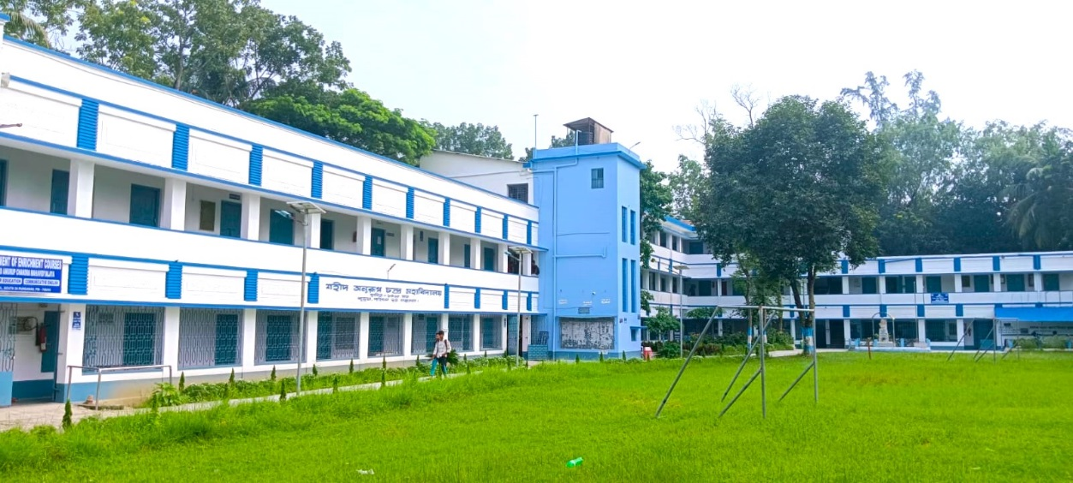

Dr. Faruk Mallick
Assistant Professor
Department of Geography
Saheed Anurup Chandra Mahavidyalaya

Slide 2


Introduction to Qualitative Research Methods.

Slide 3
Learning Objectives
Understand the concept of Qualitative Research
Learn the types of Qualitative Research
Comprehend the challenges and limitations of
Qualitative Research

Slide 4
Emergence of Qualitative Research
Qualitative Research Started out of the need to understand
the “other”.
2. Qualitative Research Studied the phenomena in its natural
setting and attempted to make sense of or interpret it in
terms of the meanings people bring to them.

Slide 5
Emergence of Qualitative Research
3. Qualitative Research begins with early ethnographic studies in 17th century .
4. Denzin and Lincoln (2005) highlight eight moments of Qualitative Research history starting from this phase titled “ The traditional period” till the eighth moment, the present and future since (2005)

Slide 6
Definition of Qualitative Research Methodology
1. Denzin and Lincon (1994) defined Qualitative Research
as a methodology which is “Multimethod in focus,
involving an interpretative ,naturalist approach to its
subject matter.
2. According to Creswell ( 1994) Qualitative Research is an
inquiry process of understanding a social or human
problems , based on building a complex , holistic
pictures , formed with words , reporting detailed
views of informants and conducted in a natural setting .

Slide 7
Definition of Qualitative Research Methodology
3. Gay and Airasian (2000) proposed that Qualitative Research
is a collection of extensive data on many variables over and
extended period of time , in a naturalistic setting , in order to
gain insights not possible using other type of research.

Slide 8
Characteristics of Qualitative Research
Qualitative Research is inductive in nature. The
research process starts at the field and the data
collected leads to theory development .
2. Qualitative Research has an strong orientation to
everyday life and events.
It believes that people’s interactions and behaviors
should not be reduced to statistical equations.

Slide 9
Characteristics of Qualitative Research
There is minimal manipulation of the research setting .The phenomena is studied as it occurs or as it is recalled without researcher’s directive control.
It consist of a spectrum of methods from which one
can be chosen depending on the research questions.
Data are gathered by flexible ,open –ended
methods and diversity of the participants
responses is valued .

Slide 10
Characteristics of Qualitative Research
It emphasis interaction between the researcher and the
researched and thus reduced distance between them . The term “researched “ is used to denote the two way relationship rather than “respondents “.
8. It recognizes the inevitability of influences from researcher's personal characteristics and alignments like philosophical orientations, gender, social class, race and ethnicity.

Slide 11

Thanks ………

