Slide 1
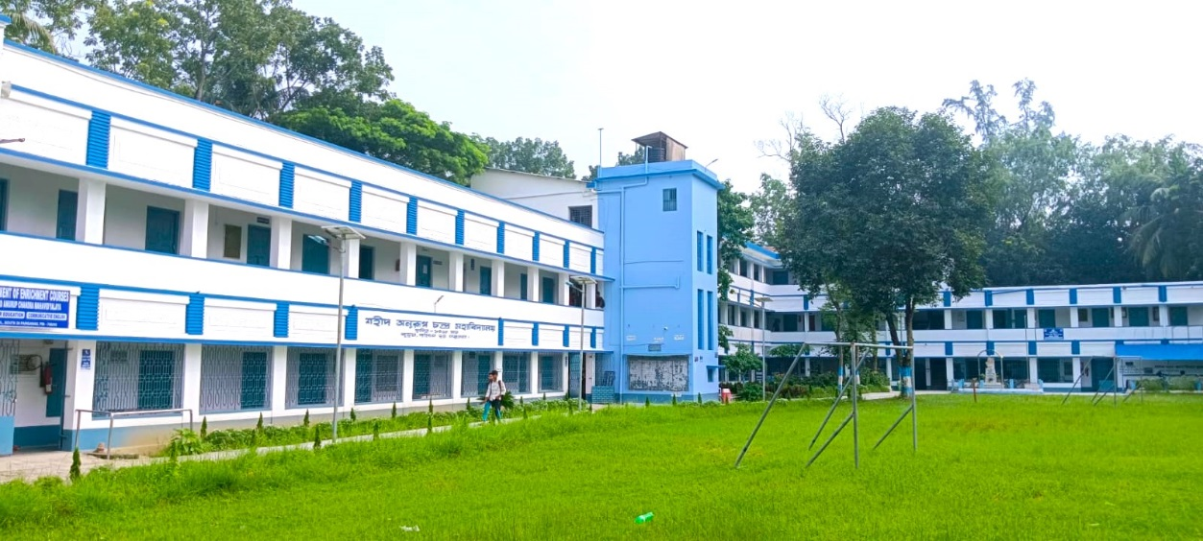
RESEARCH PROBLEM
Dr. Faruk Mallick
Assistant Professor
Department of Geography
Saheed Anurup Chandra Mahavidyalaya

Slide 2
Research Problem??
It refers to some difficulty which a researcher experiences in the context of either a theoretical or practical situation.
One wants to obtain a solution for the same.

Slide 3
Conditions that must met for the existence of a research problem
An individual (or a group or an organisation), to whom the problem can be attributed.
At least two courses of action, to be pursued.
At least two possible outcomes of the course of action, of which one should be preferable to the other.
The courses of action available must provide some chance of obtaining the objective.

Slide 4
Components of a research problem
An individual or a group which has some difficulty or the problem.
Some objective(s) to be attained at.
At least two courses of action for obtaining the objective(s).
Researcher must answer the question concerning the relative efficiency of the possible alternatives.
There must be some environment(s) to which the difficulty pertains.

Slide 5
Points to be considered for selecting a research problem
Subject which is overdone should not be normally chosen.
Controversial subject should not be chosen.
Too narrow or too vague problems should be avoided.
The subject should be familiar and feasible.
One must have read articles published in current literature.
Must be focused and must result into the innovation of some new findings and methodology.
Costs involved and the time factor.
Level of Interest.

Slide 6
Few questions to be answered to oneself
Whether he is well equipped in terms of his background to carry out the research?
Whether the study falls within the budget he can afford?
Whether the necessary cooperation can be obtained from those who must participate in research?
Whether the research can be finished in a certain fixed period of time?

Slide 7
Necessity of Defining the Problem
What data are to be collected?
What characteristics of data are relevant and need to be studied?
What relations are to be explored?
What techniques are to be used for the purpose?
Thus, defining a research problem properly is a prerequisite for any study and is a step of the highest importance.

Slide 8
Techniques Involved in Defining a Problem
Statement of the problem in a general way.
Understanding the nature of the problem.
Surveying the available literature.
Developing the ideas through discussions.
Rephrasing the research problem.

Slide 9
Conclusions
It follows a sequential pattern
the problem is stated in a general way.
the ambiguities are resolved.
thinking and rethinking process results in a more specific
formulation of problem so that it may be a realistic in
terms of the available data and resources.
This results in
a well defined research problem that is meaningful.
equally capable of paving the way for the development of
working hypotheses.
solving the problem itself.

Slide 10
Thank you

