Slide 1
Cost & Management-1
Sem-II
Labour
Chiranjit Ghosh
Department of Commerce

Slide 2
Types of Labour
Engagement:
Regular Labours.
Casual Labours.
Hired Labours.
Out Workers.
  Skilled:
                Skilled Labour
                Unskilled Labour

Slide 3
Time Keeping
Manual Recording
Hand Recording
Dise/Token Recording
Mechanical Recording
Time clock Method
Dial Recording Method
Key Recording Method

Slide 4
Methods of Remuneration/Wages
On the basis of Time
On the basis of Output
Time Rate System
High Wages Plan
Graduated Time Rate System
Differential Time Rate System
Straight Piece Rate System
Taylor Differential Piece Rate System
Merrick Differential Piece Rate System
Gantt Task Bonus System
Emersion Efficiency system
Premium Bonus Plans
  Halsey Scheme
  Rowan Scheme

Slide 5
Graduated Time Rate System
Fixed Rate (depends on nature of work)
+
Variable Rate (depends on individual merit/cost of living)

Slide 6
Differential Time Rate System
Efficiency Level : Wage Rate (Rs.)
= 60% 2.00
>60% but </=65% 2.20
>65% but </=70% 2.40
>70% but </=75% 2.60
so on………

Slide 7
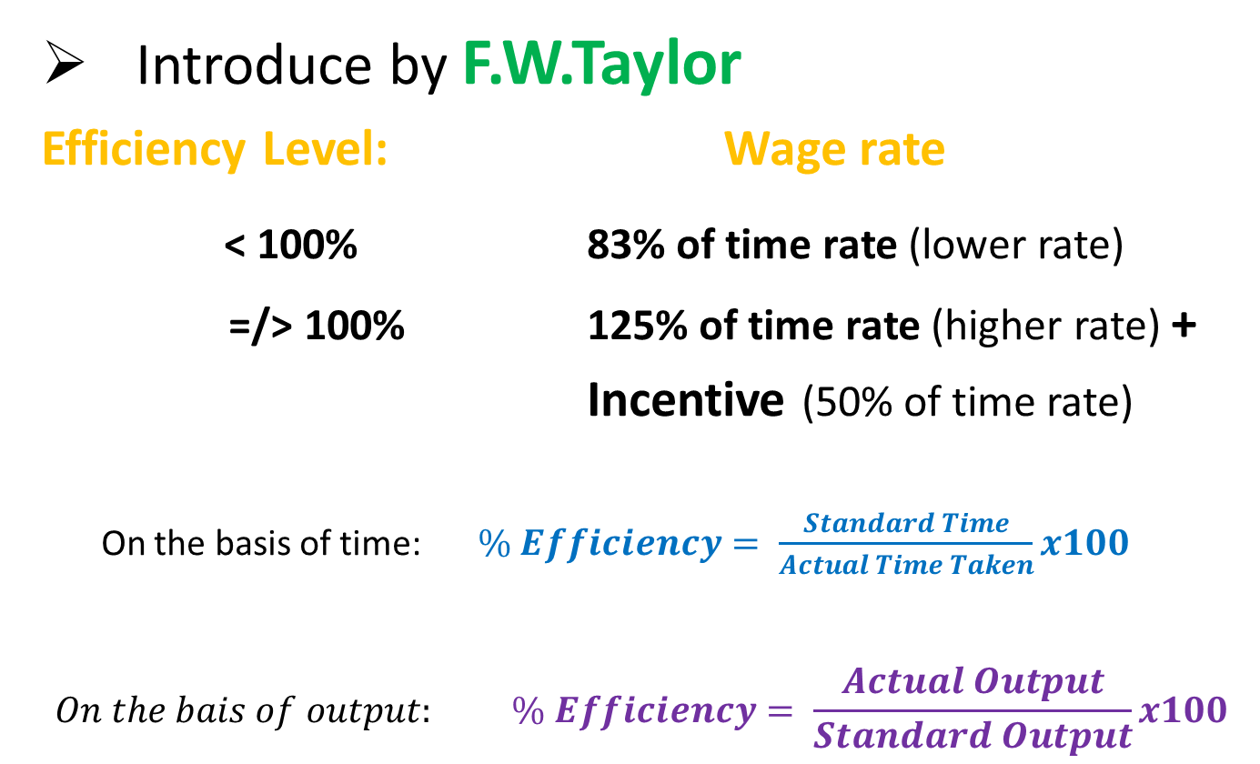
Taylor Differential Piece Rate System
Introduce by F.W.Taylor
Efficiency Level: Wage rate
< 100% 83% of time rate (lower rate)
=/> 100% 125% of time rate (higher rate) +
Incentive (50% of time rate)
On the basis of time: $\% Efficiency= \frac{Standard Time}{Actual Time Taken}x100$
$$On the bais of output: \% Efficiency= \frac{Actual Output}{Standard Output}x100$$

Slide 8
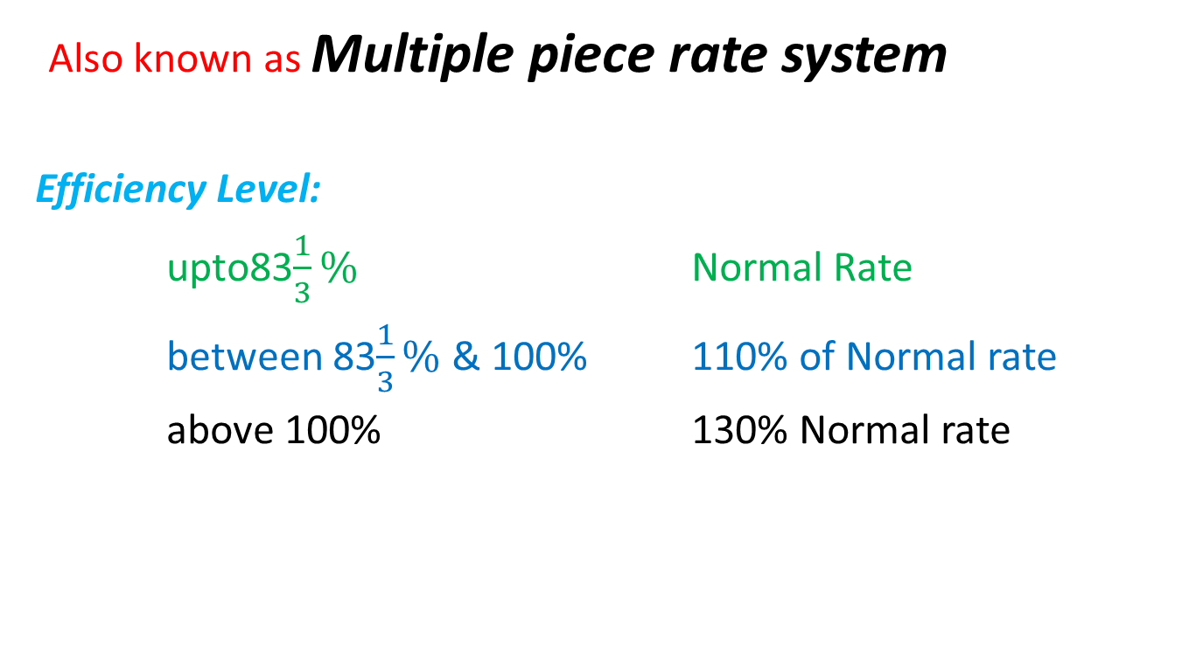
Merrick Differential Piece Rate System
Also known as Multiple piece rate system
Efficiency Level:
upto83$\frac{1}{3}\%$ Normal Rate
between 83$\frac{1}{3}\%$ & 100% 110% of Normal rate
above 100% 130% Normal rate

Slide 9
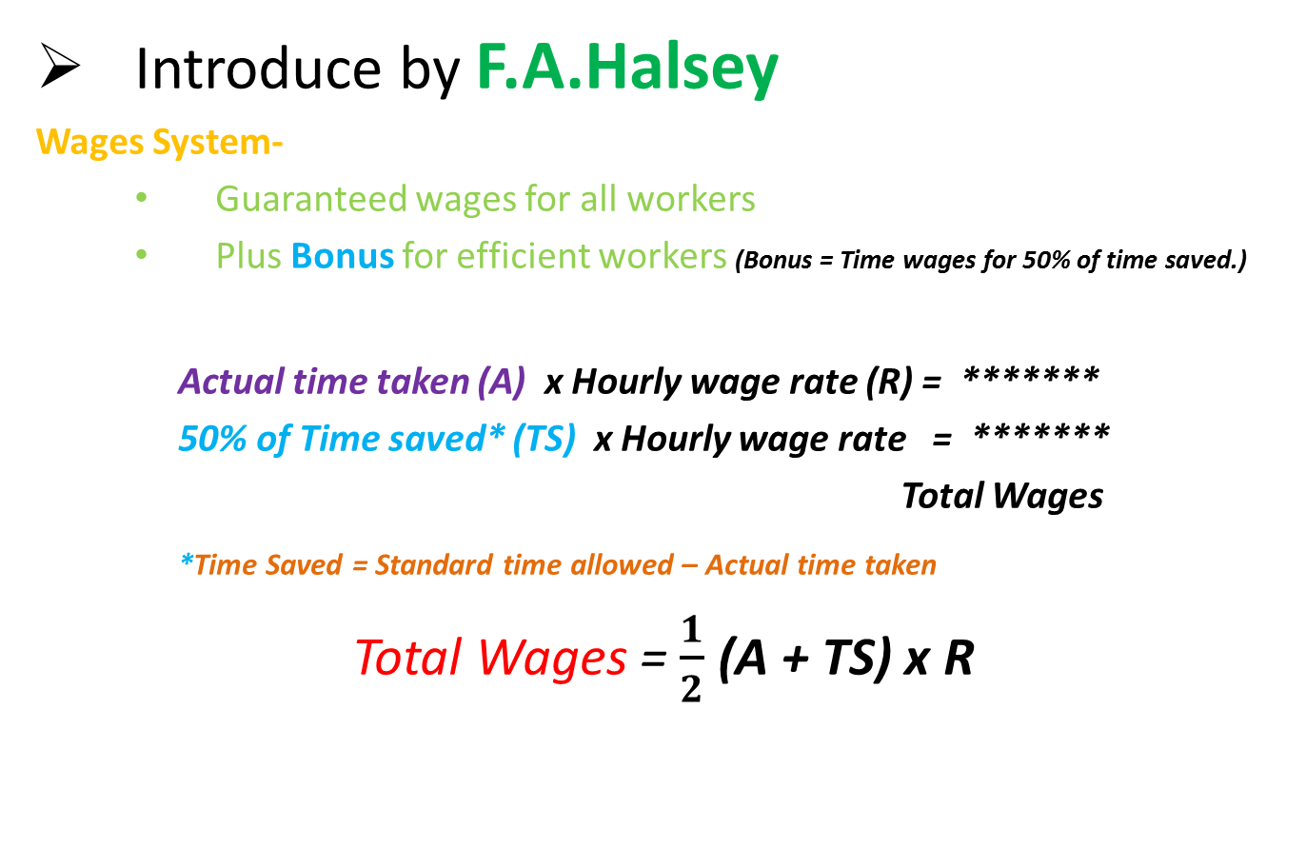
  Premium Bonus Plans - Halsey Scheme
Introduce by F.A.Halsey
Wages System-
Guaranteed wages for all workers
Plus Bonus for efficient workers (Bonus = Time wages for 50% of time saved.)
Actual time taken (A) x Hourly wage rate (R) = *******
50% of Time saved* (TS) x Hourly wage rate = *******
Total Wages
*Time Saved = Standard time allowed – Actual time taken
Total Wages = $\frac{1}{2}$ (A + TS) x R

Slide 10
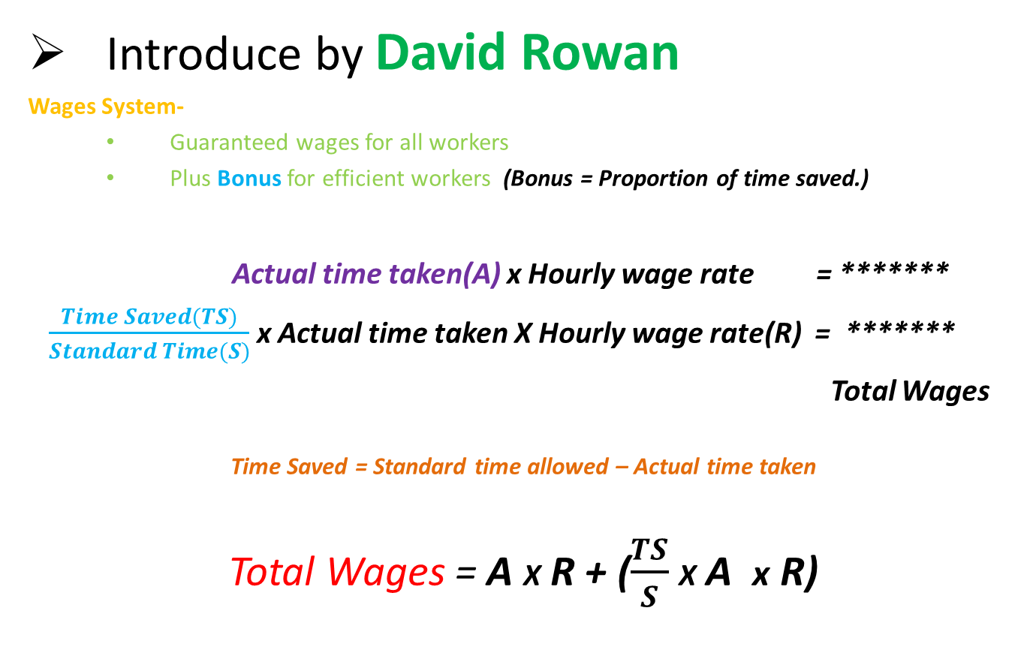
  Premium Bonus Plans - Rowan Scheme
Introduce by David Rowan
Wages System-
Guaranteed wages for all workers
Plus Bonus for efficient workers (Bonus = Proportion of time saved.)
Actual time taken(A) x Hourly wage rate = *******
$\frac{Time Saved(TS)}{Standard Time(S)}$ x Actual time taken X Hourly wage rate(R) = *******
Total Wages
Time Saved = Standard time allowed – Actual time taken
Total Wages = A X R + ($\frac{TS}{S}$ X A x R)

